Slide 1
Production and Distribution
Rajiv Sethi and the CORE Team
October 18, 2021

Slide 2
Overview
Institutional arrangements for production and distribution
Production under sole proprietorship
Production and distribution under coercion
Production and distribution with a labor contract
Effects of changes in outside options
Effects of changes in preferences
Firms with many employees
Reading: The Economy Unit 5 Introduction, 5.1 to 5.7

Slide 3
Institutional Arrangements

Slide 4
Institutional Arrangements
Across time and space, conditions for production differ
In US today most goods/services produced by privately owned firms
Includes sole proprietorships (people working for themselves)
Also includes partnerships and corporations
Some production by government owned entities (post office)
Proceeds from sales are divided between owners and employees
Institutions affect how much is produced, and how it is shared
Start with sole proprietor

Slide 5
Sole Proprietorship

Slide 6
Sole Proprietorship
Angela is sole proprietor, owns land and works for herself
Can spend time and effort to produce grain for sale
She values free time and output, but must spend one to get the other
More output means less free time
Technological possibilities can be represented by a feasible frontier
Slope of frontier at any point is the marginal rate of transformation
This shows how much time must be lost to get a bit more grain
MRT falls as one moves left: gets harder and harder to produce more

Slide 7
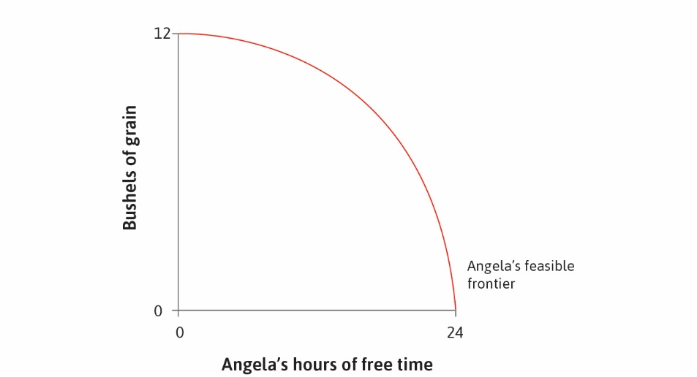

Slide 8
The Production Decision
How much will Angela produce? Depends on preferences
Preferences can be represented using indifference curves (as before)
Since both free time and output are valuable, curves slope down
Slope of indifference curve at any point is marginal rate of substitution
MRS rises as one moves left since free time is most valuable when scarce
Optimal choice is on highest attainable indifference curve
Point of tangency, equating MRS and MRT

Slide 9
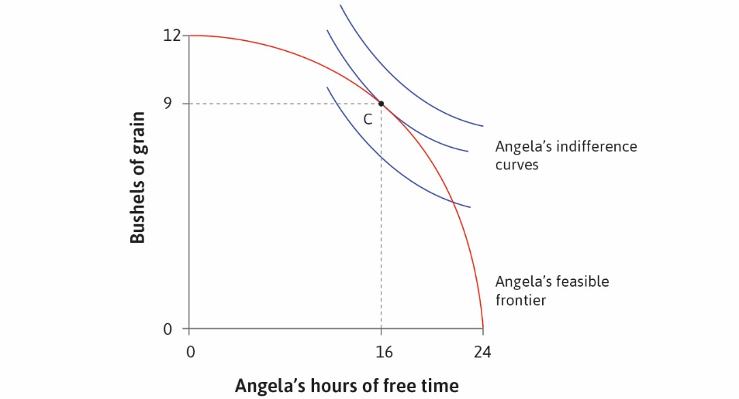

Slide 10
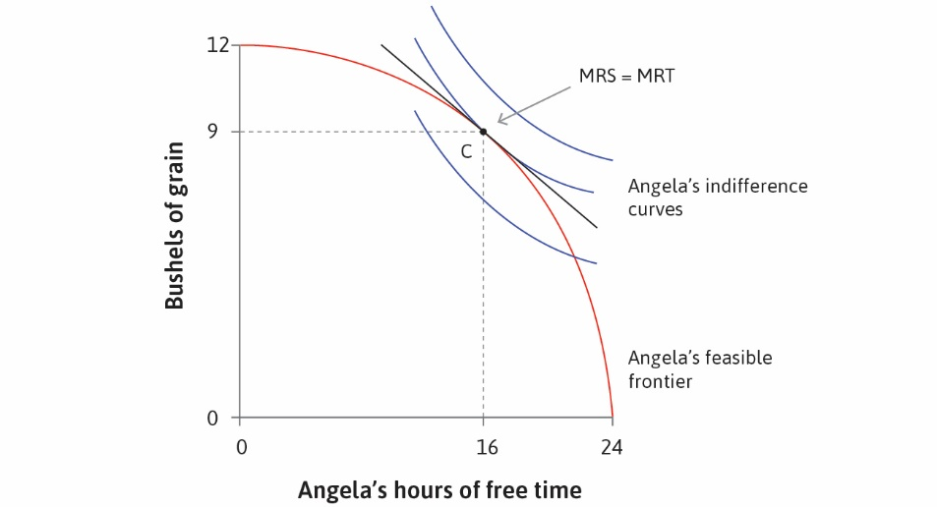

Slide 11
Production under Coercion

Slide 12
Coercion
Now suppose Bruno owns the land, Angela produces output
Total output divided between Angela and Bruno
Extreme case: Bruno can coerce Angela to work, pays survival wages
Even in this case, more work requires more wages
Angela’s survival constraint defines the feasible set
Suppose Bruno sets hours and wages to maximize what he receives
He will equate MRT with slope of survival constraint
Angela’s preferences not taken into account, so MRS and MRT unequal

Slide 13
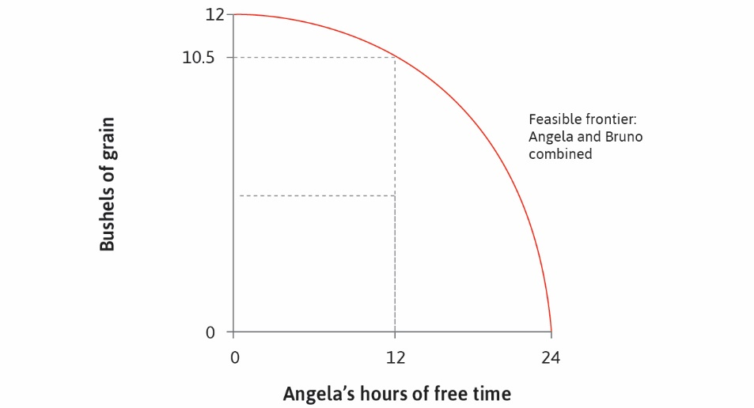

Slide 14
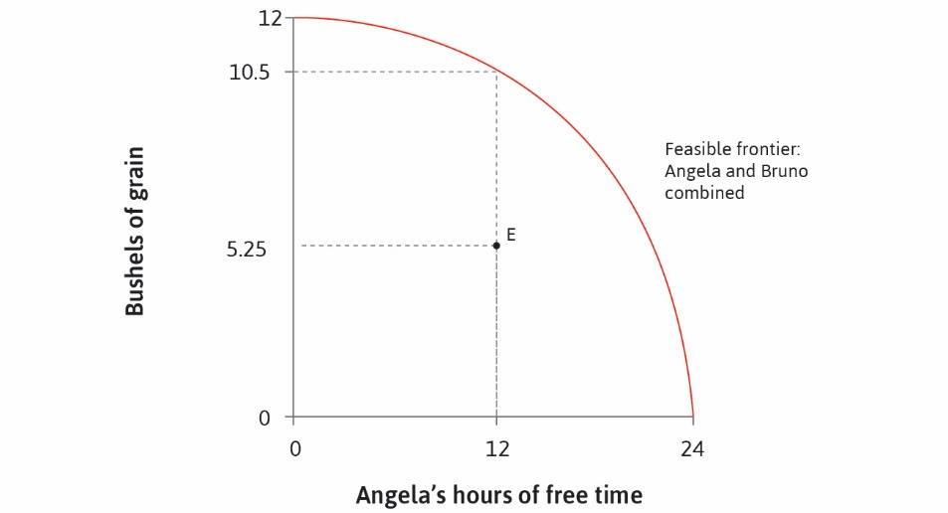

Slide 15
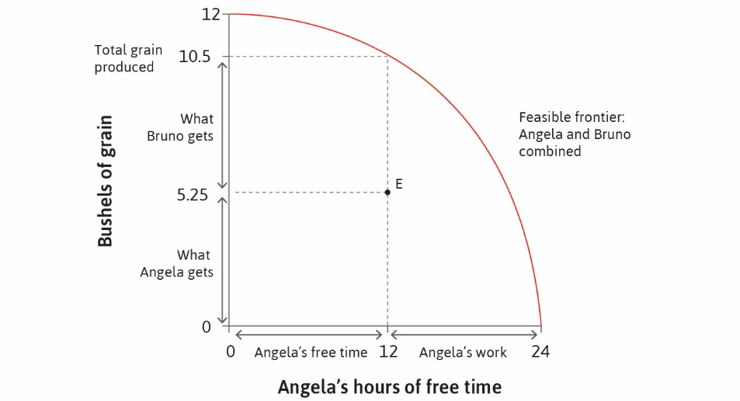

Slide 16
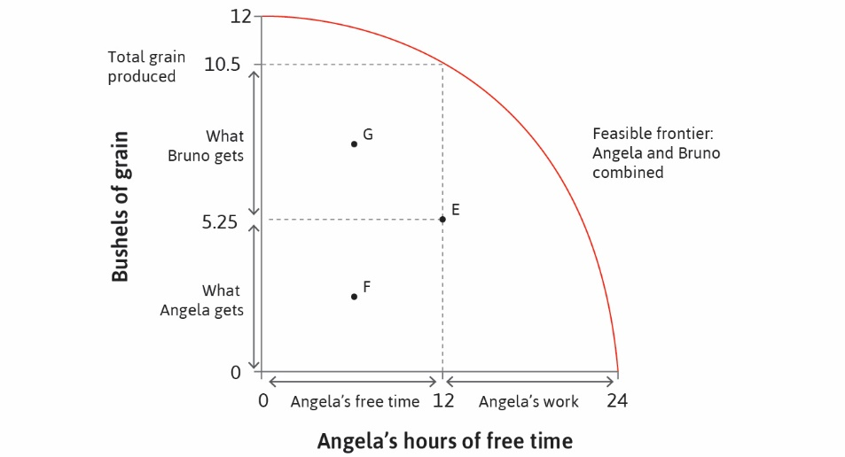

Slide 17


Slide 18
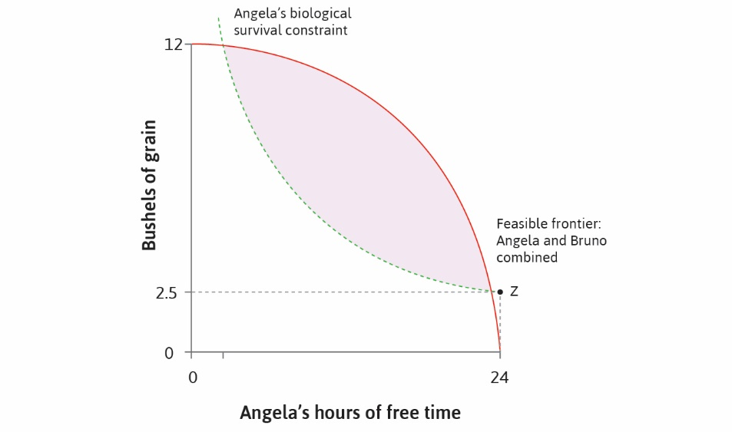

Slide 19
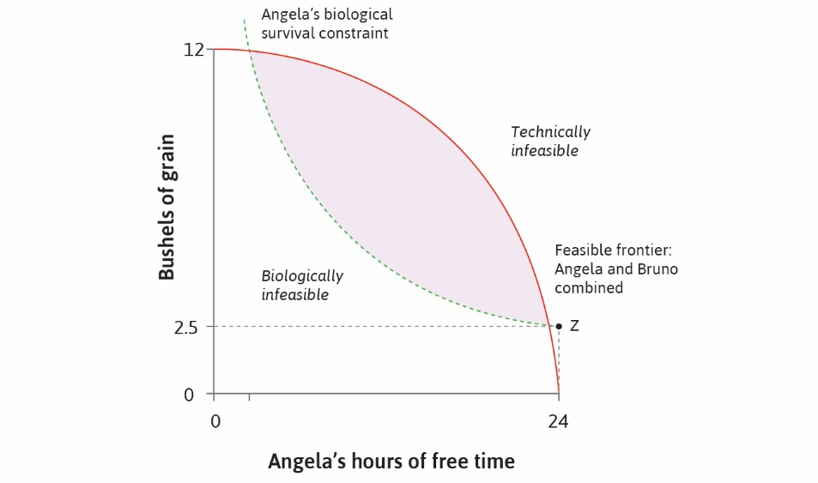

Slide 20
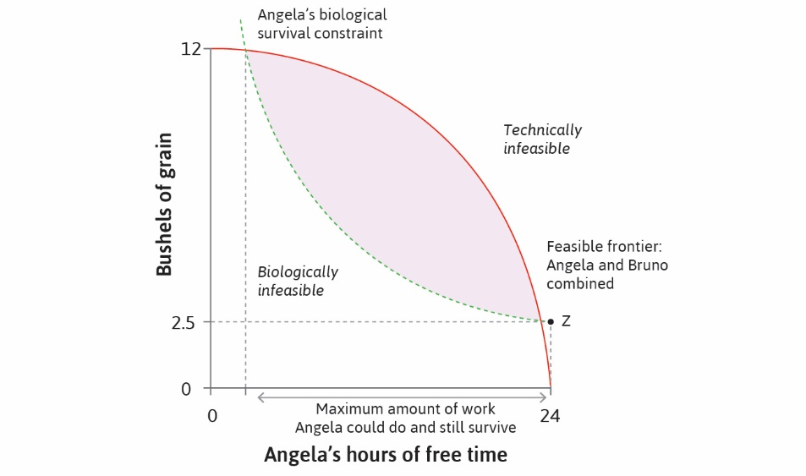

Slide 21
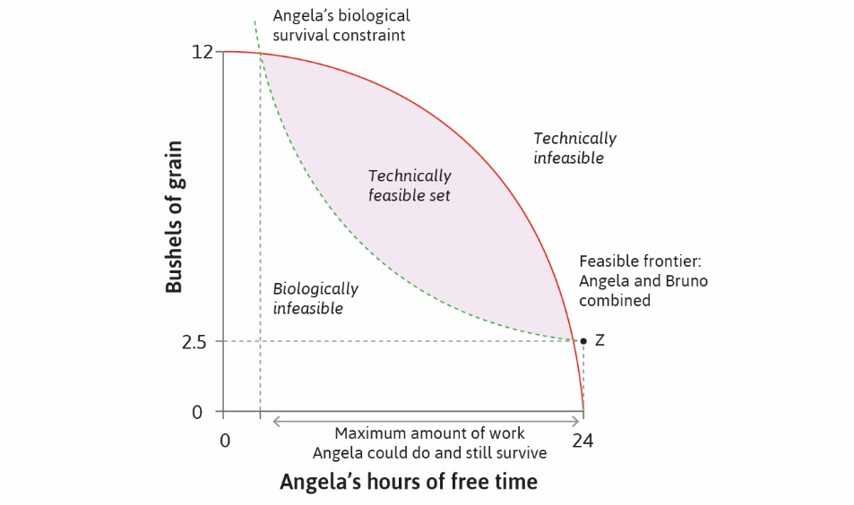

Slide 22
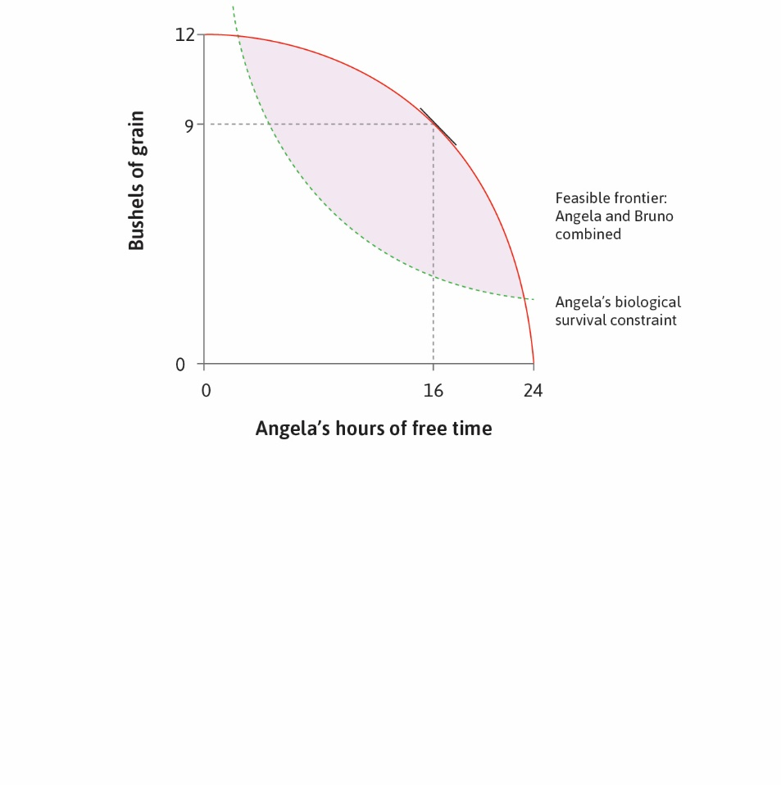

Slide 23
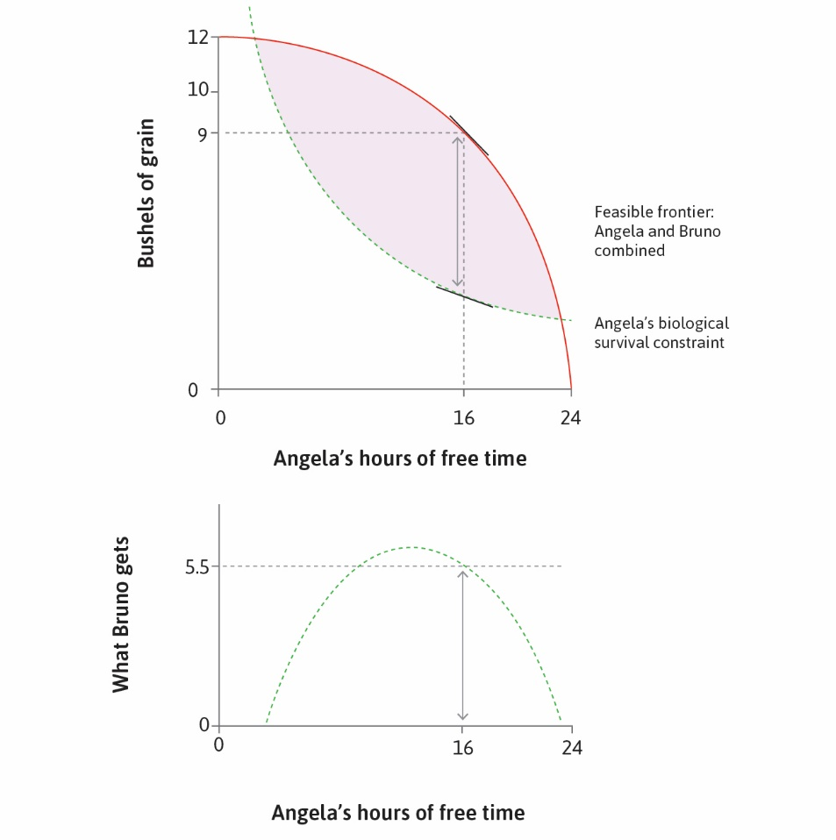

Slide 24
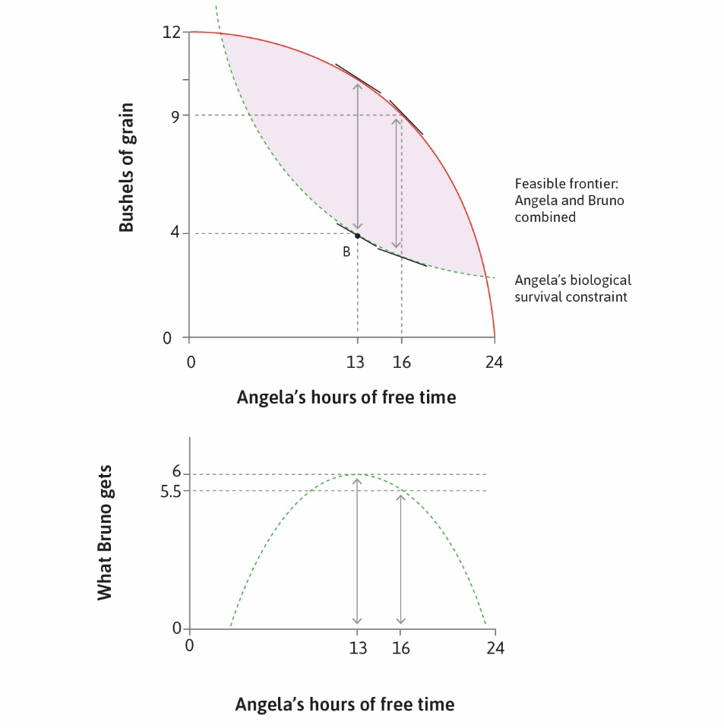

Slide 25
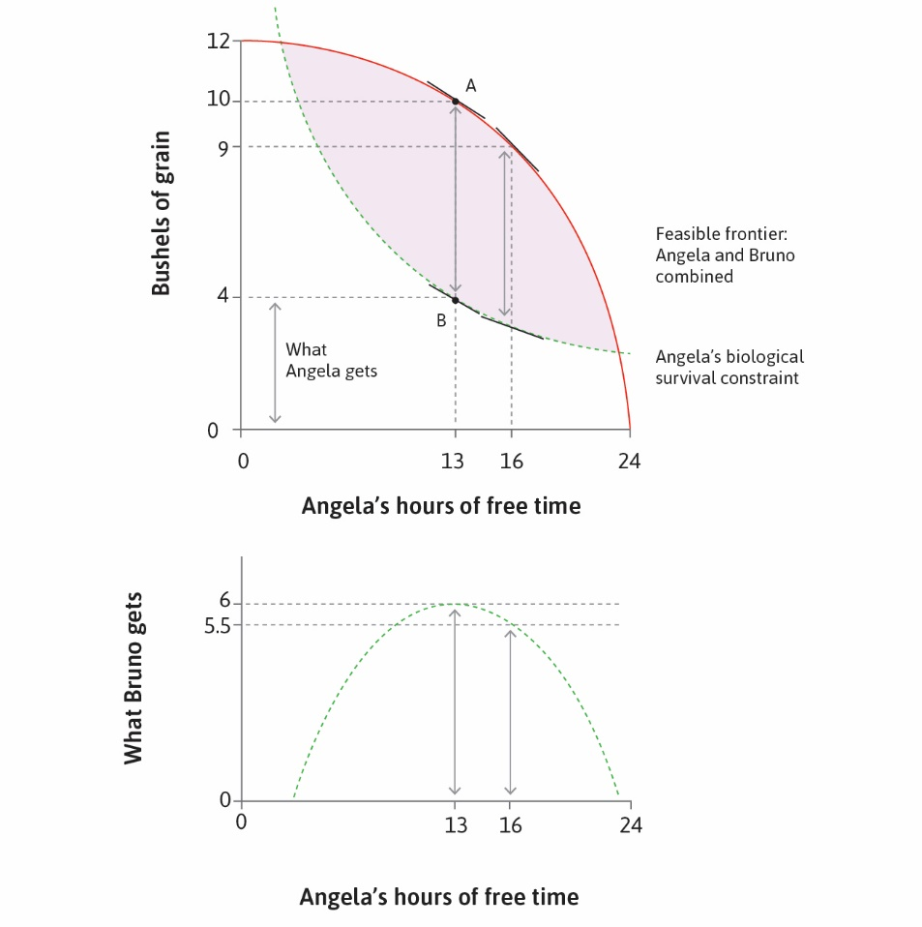

Slide 26
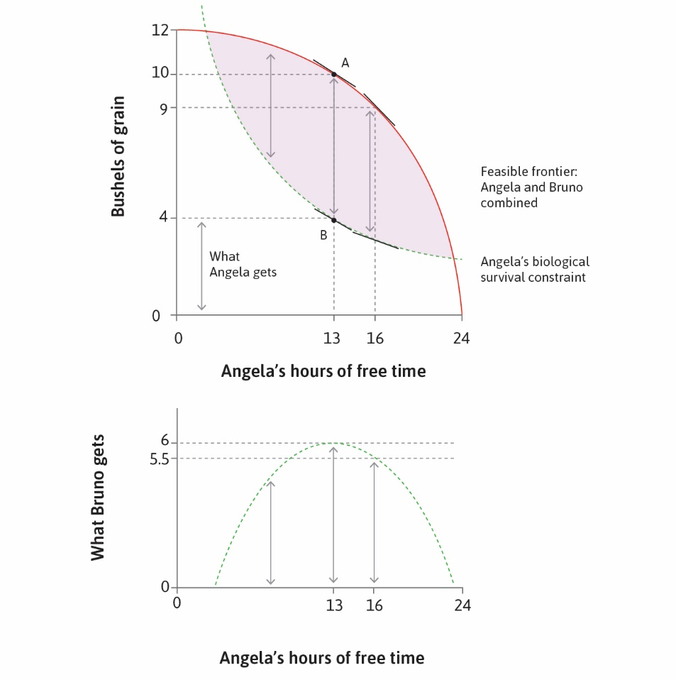

Slide 27


Slide 28
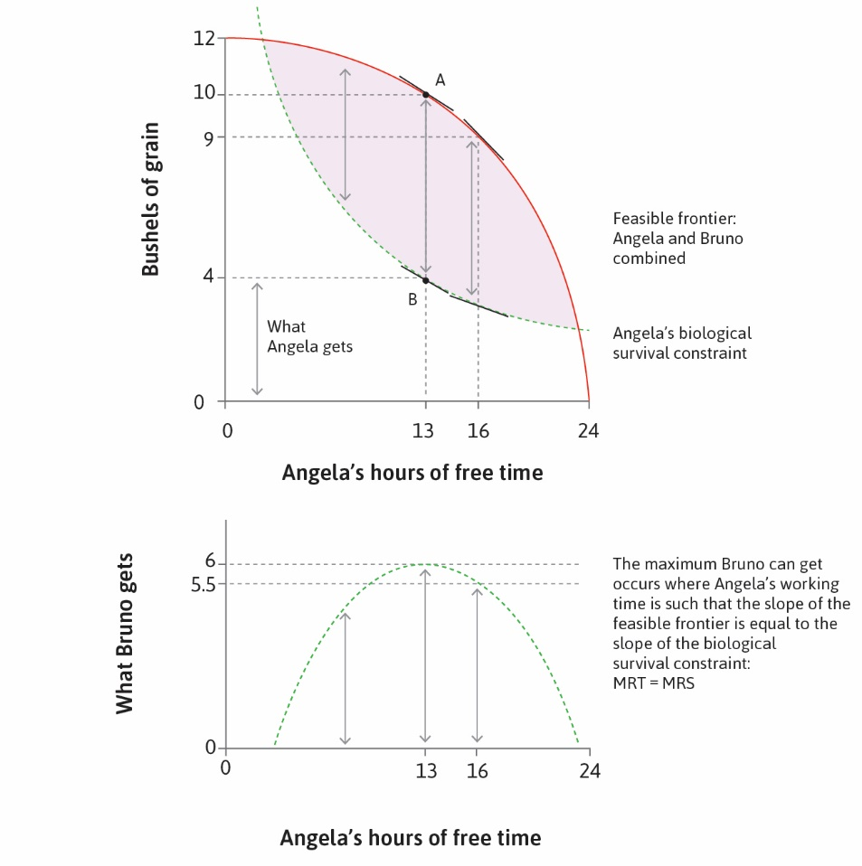

Slide 29
Labor Contracts

Slide 30
Labor Contracts
Now suppose Angela can choose to accept or decline employment
Bruno offers Angela a labor contract (hours and compensation)
Angela has an outside option: amount received if she declines offer
Suppose outside option is equivalent to 2.5 bushels of grain
She will accept consider the indifference curve through outside option
This determines the economically feasible set (set of acceptable contracts)
Bruno offers contract within this set that maximizes his gain
In this case MRS and MRT are again equated

Slide 31
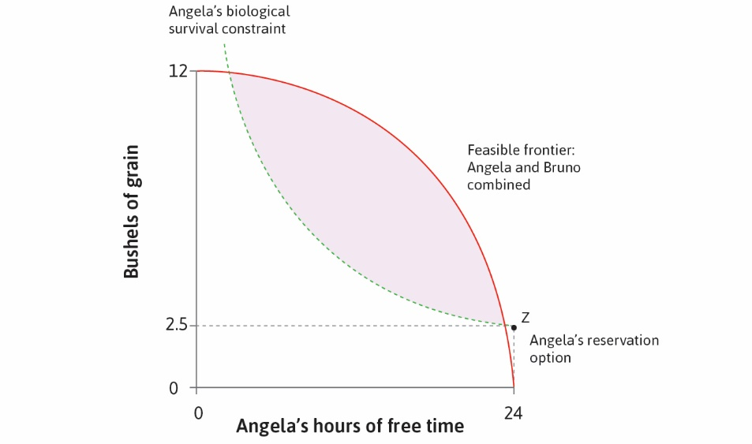

Slide 32
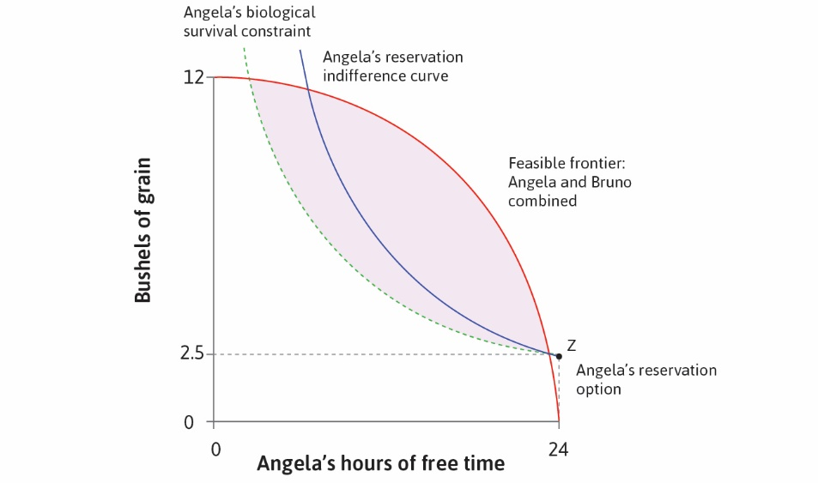

Slide 33
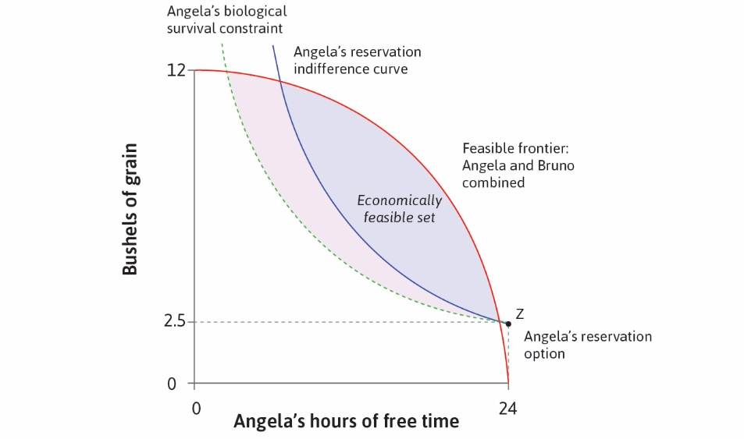

Slide 34
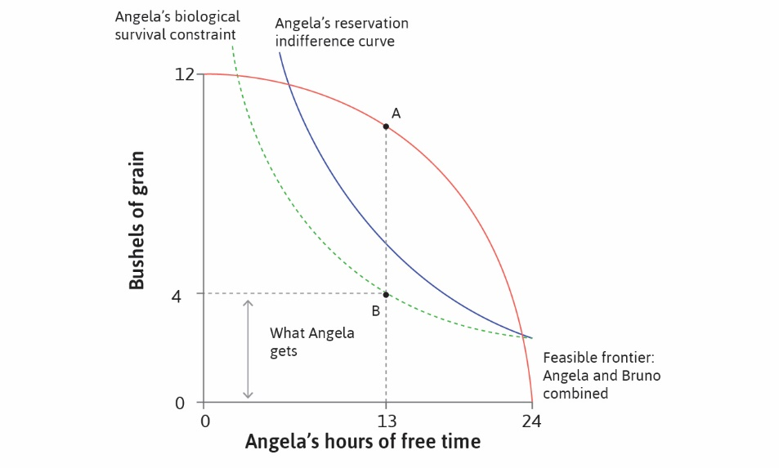

Slide 35
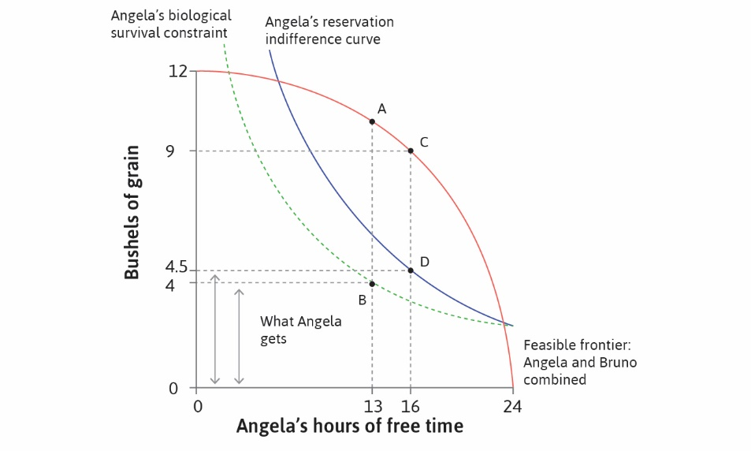

Slide 36
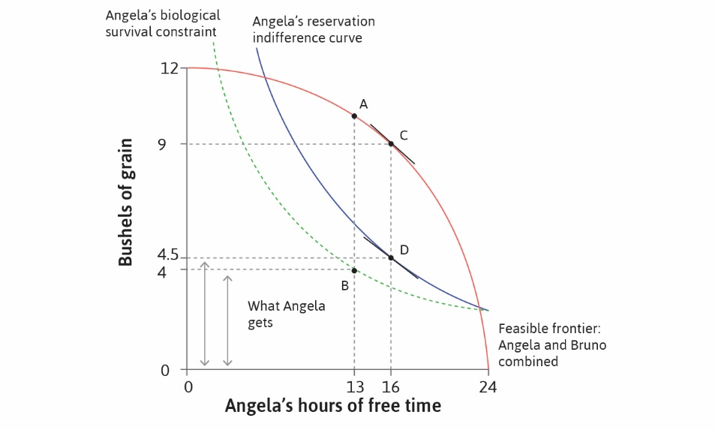

Slide 37
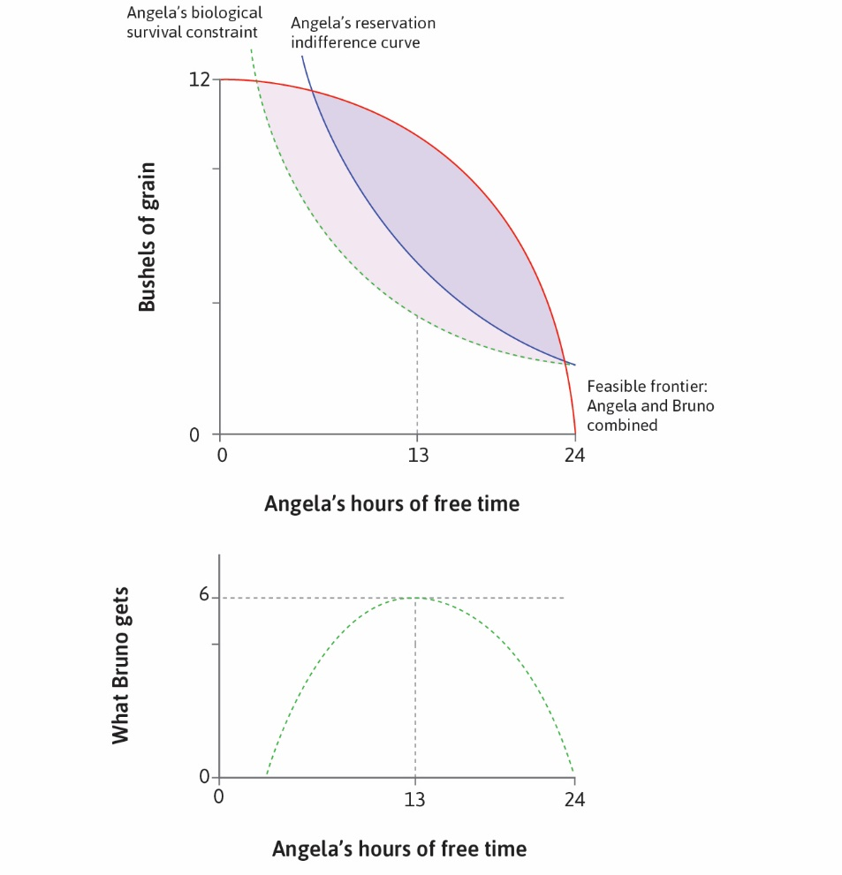

Slide 38
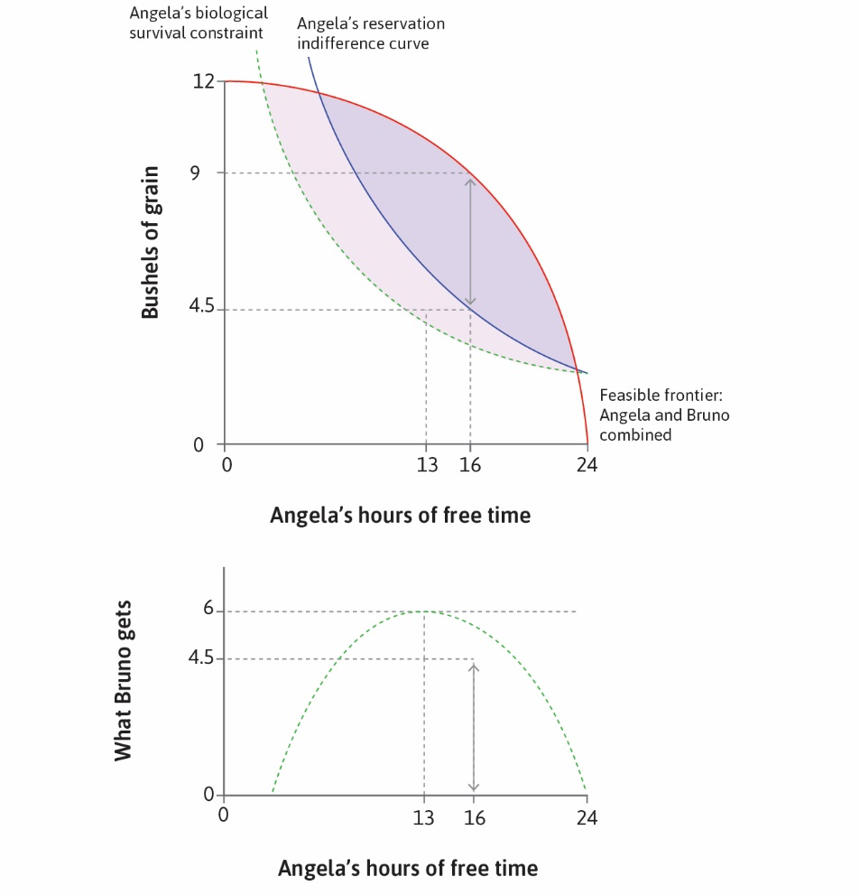

Slide 39
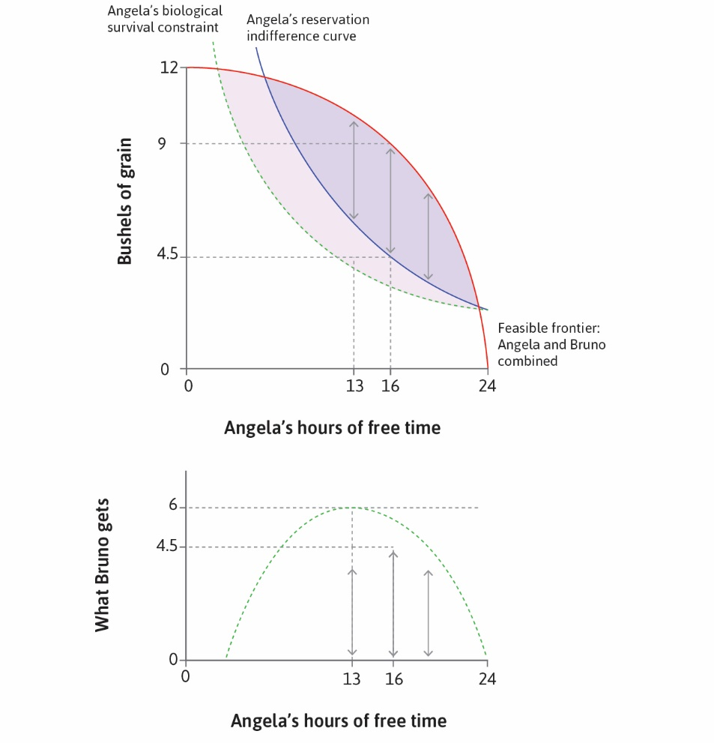

Slide 40
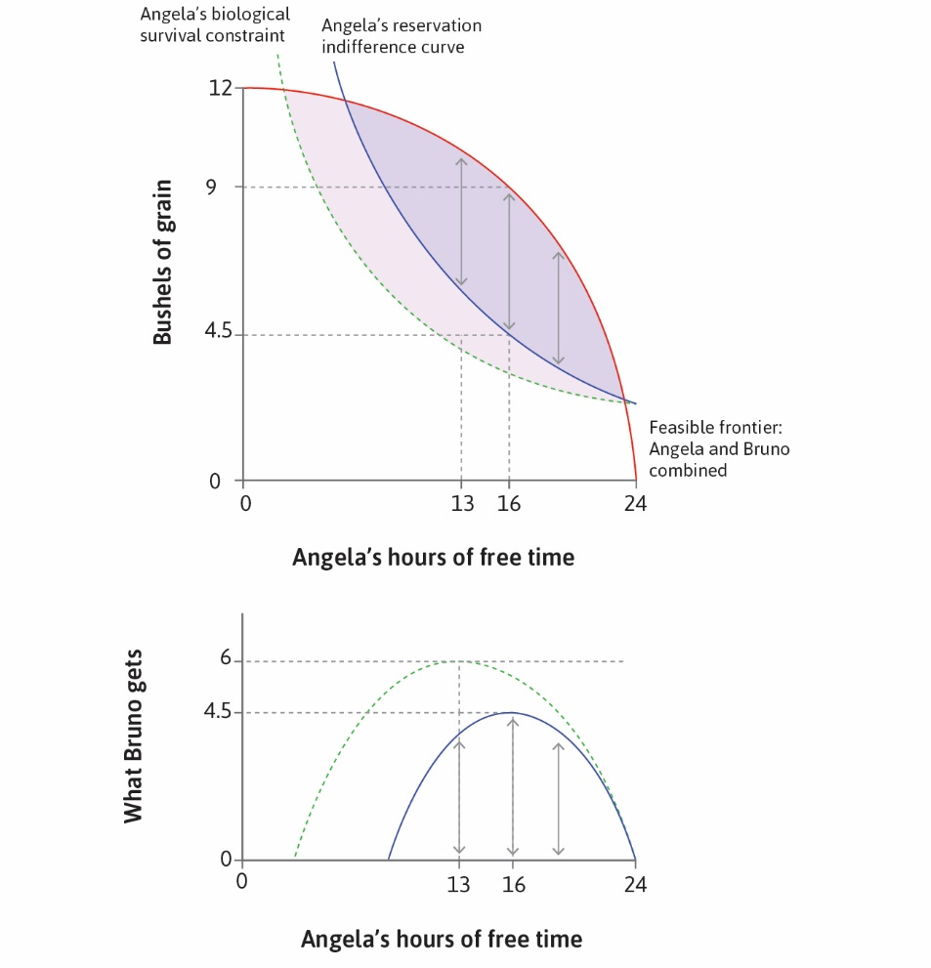

Slide 41
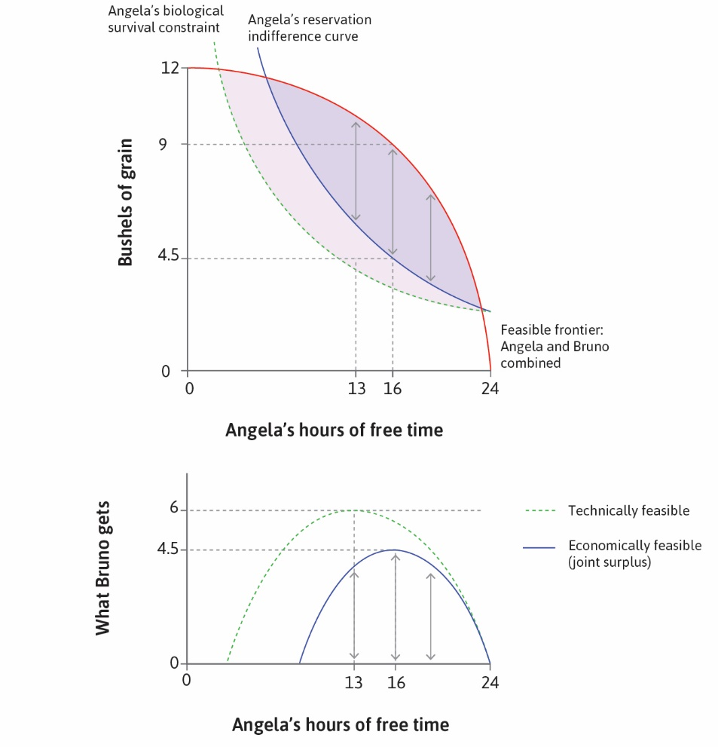

Slide 42
Comparing Institutions

Slide 43
Output under Different Institutions
Notice: total output is same under sole proprietorship and labor contract
Only the distribution of output is different
This is not generally true: only true with parallel indifference curves
Only true if MRS at any given output level is the same on all curves
Otherwise both level and distribution of output will change
Proprietorship, coercion, contract can all result in different output levels
And also on the way that output is distributed

Slide 44
Preferences and Options

Slide 45
Changes in Outside Options
Suppose that Angela’s outside option improves
For example: greater unemployment benefits
How does this affect the economically feasible set?
How does it affect the amount that Bruno will get?
Will output change if Angela’s indifference curves are parallel?
Will output change if Angela’s indifference curves are not parallel?

Slide 46
Changes in Preferences
Suppose that Angela’s indifference curves become steeper
So MRS is higher at each output level
How does this affect the economically feasible set?
How does it affect output?
How does it affect the amount that Bruno will get?
Is it possible that Angela will get paid less?

Slide 47
Multiple Employees

Slide 48
Multiple Employees
Most firms have many employees; Walmart has over 2 million globally
Cannot usually offer different contracts to each employee
Employees generally partitioned into categories
Suppose there are category-specific hours and compensation
In general, MRS cannot equal MRT for all those in the same category
Need to offer contract to fill employment needs
One or more workers may be (roughly) indifferent, others will not
Greater demand for labor will result in better working conditions
Example: the post-pandemic economy

Slide 49
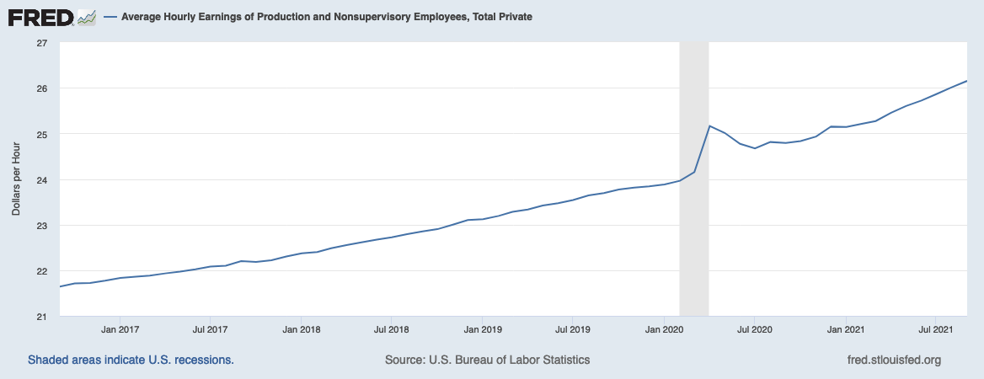
View latest data and differences by sector

